Slide 1
Theory of Automata
Lecture #22-23-24

Slide 2
Definition
The language generated by CFG
Consists of those strings which can be produced from the start symbol S using the production Rules
The language generated by CFG is called Context Free Language(CFL)

Slide 3
Ambiguity
A CFG is said to be ambiguous if there is at least 1 string in L(G) having two or more distinct derivations
Notes:
L(G) language generated by grammer

Slide 4

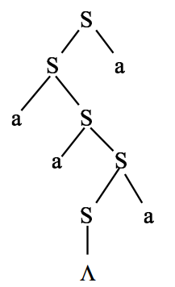
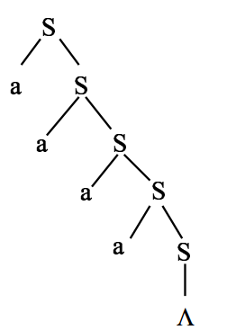
Ambiguity

Slide 5
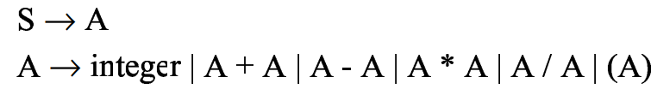
Arithmetic Expression Example

Slide 6
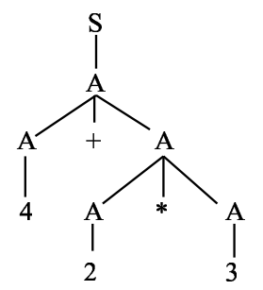
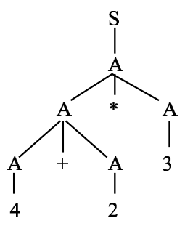
Arithmetic Expression Example
4+2*3

Slide 7
So Ambiguity is
A CFG is ambiguous if there is some word it generates which has two different parse trees
A CFG that is not ambiguous is called unambiguous

Slide 8
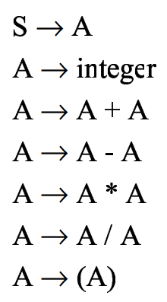
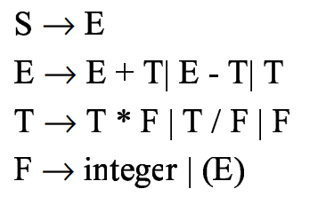
Arithmetic Expressions
E - Expression
T - Term
F - Factor
E is expression, T is term of expression and F is factor of a term
Notes:
E is expression, T is term of expression and F is factor of a term

Slide 9
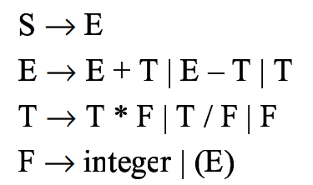
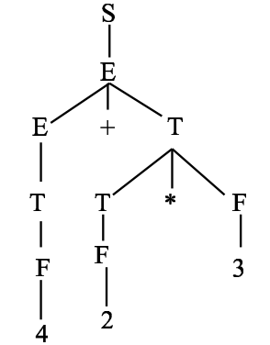
Derivation of 4+2*3 using AE
Productions
Derivation
E - Expression
T - Term
F - Factor
E is expression, T is term of expression and F is factor of a term

Slide 10
Note
Identify same priority
Move right to left
First solve lowest priority
Then highest priority
Replacement of productions

Slide 11
Simple Example
Suppose CFG is
(1) S → S + S
(2) S → 1
(3) S → a
Generate the string from the given CFG
1 + 1 + a

Slide 12
Derivation
S → S+S (rule 1 on first S)
→ S+S+S (rule 1 on second)
→ S+1+S (rule 2 on second S)
→ S+1+a (rule 3 on third S)
→ 1+1+a (rule 2 on first S)

Slide 13
Types of Derivations
Leftmost derivation, it is always the leftmost nonterminal
Rightmost derivation, it is always the rightmost nonterminal

Slide 14
Left Most Derivation
S → S+S (rule 1 on first S)
→ 1+S (rule 2 on first S)
→ 1+S+S (rule 1 on first S)
→ 1+1+S (rule 2 on first S)
→ 1+1+a (rule 3 on first S)

Slide 15
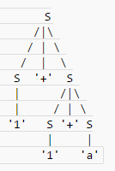
Left Most Derivation

Slide 16
Right Most Derivation
S → S + S (Rule-1)
→ S + a (Rule-3)
→ S + S + a (Rule-1)
→ S + 1 + a (Rule-2)
→ 1 + 1 + a (Rule-2)

Slide 17
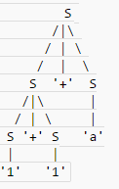
Right Most Derivation

Slide 18

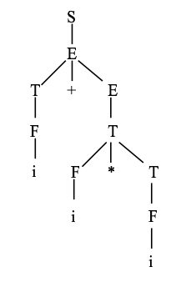
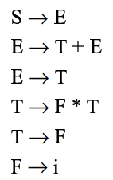
Parse Tree from given input string
Parse Tree
Grammar
E - Expression
T - Term
F - Factor
E is expression, T is term of expression and F is factor of a term

Slide 19


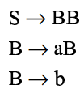
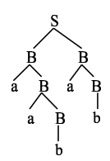
Parse Tree from given input string
Language:
Input String:
Grammar
Parse Tree

Slide 20
Algebraic expressions
Here is a context-free grammar for syntactically correct infix algebraic expressions in the variables x, y and z:
S → x
S → y
S → z
S → S + S
S → S - S
S → S * S
S → S / S
S → ( S )
Notes:
Normally algebraic expression is given in he infix form where operator is placed between operands

Slide 21
Generate Following String
( x + y ) * x - z * y / ( x + x )
Note that:
x, y, z are terminals
S is non-Terminal
Notes:
- then

Slide 22
String Generation
S → S - S (by rule 5)
→ S * S - S (by rule 6, applied to the leftmost S)
→ S * S - S / S (by rule 7, applied to the rightmost S)
→ ( S ) * S - S / S (by rule 8, applied to the leftmost S)
→ ( S ) * S - S / ( S ) (by rule 8, applied to the rightmost S)
→ ( S + S ) * S - S / ( S ) (etc.)
→ ( S + S ) * S - S * S / ( S )
→ ( S + S ) * S - S * S / ( S + S )
→ ( x + S ) * S - S * S / ( S + S )
→ ( x + y ) * S - S * S / ( S + S )
→ ( x + y ) * x - S * y / ( S + S )
→ ( x + y ) * x - S * y / ( x + S )
→ ( x + y ) * x - z * y / ( x + S )
→ ( x + y ) * x - z * y / ( x + x )
S → x
S → y
S → z
S → S + S
S → S - S
S → S * S
S → S / S
S → ( S )
Notes:
x,y,z are terminals and S is non-Terminal

Slide 23
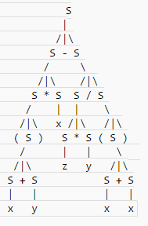
Parse Tree

Slide 24
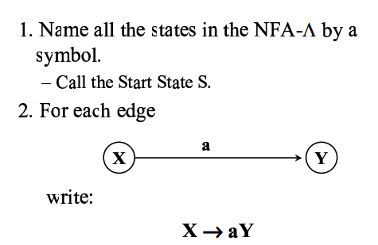
NFA-Ʌ to CFG

Slide 25
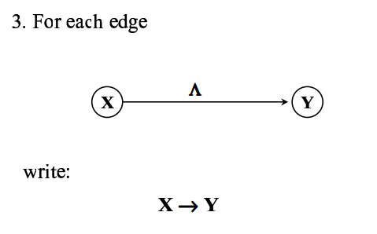
NFA-Ʌ to CFG

Slide 26
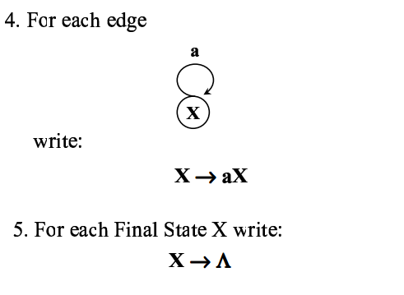
NFA-Ʌ to CFG

Slide 27
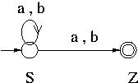
NFA to CFG
S aS
S bS
S bZ
S aZ
Z ^

Slide 28
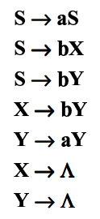
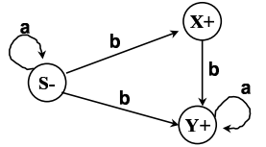
NFA to CFG

Slide 29
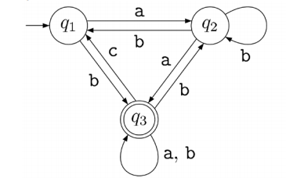
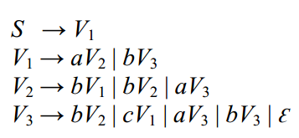
NFA to CFG
NFA
V1
V2
CFG
V3
Here, the variables V1, V2, and V3 represent the states q1, q2, and q3 of the NFA.
And, since, the state q3 is a final state, we added the rule, V3 → Ɛ to the grammar

